Slide 1
How to Measure Medium-Term Outcomes from Online Educational Activities
Guest Starring Sarah Hensley, State 4-H
Matt Benge, Amy Harder, Glenn Israel
Program Development and Evaluation Center (PDEC)
Department of Agricultural Education & Communication

Slide 2
Logistics
We will be recording this webinar. Please turn off your camera if you do not wish to be recorded.
Use the chat feature to ask questions.

Slide 3
Overview
Participants will be able to identify in which situations it is appropriate to measure medium-term outcomes from online educational programs.
Participants will increase their confidence for reporting data from online educational programs in 2020.
Participants will increase their knowledge of methods and tools that should be integrated into program evaluation plans for 2021.

Slide 4
Extension Program
Program Key Points
Quality over Quantity
“Achieve”
What educational programs will lead to your intended outcomes?
An Extension program is defined as a set of planned multiple activities (workshops, lecturing, field trips, demonstrations, etc.) conducted over a period of time to achieve a pre-defined set of objectives (e.g., change in clientele behavior or attitude).
Programs without measurable outcomes are really just activities.

Slide 5
Extension Program Life Cycle

Slide 6
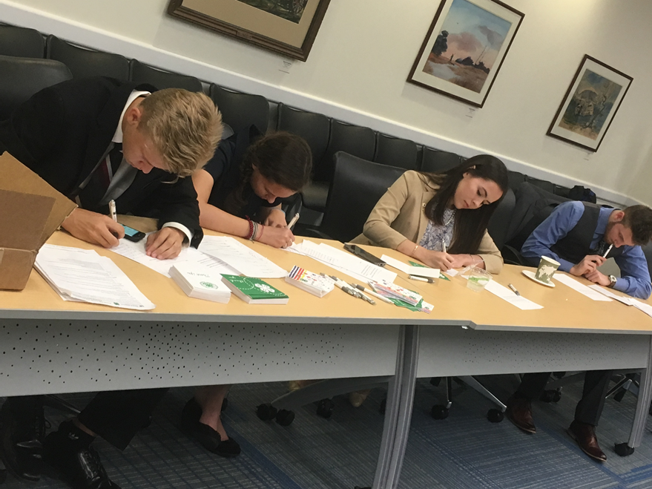
Evaluation of Virtual 4-H Programs
Keep You End Goal in Mind!
Just because the way your program is delivered (output) has changed does not mean your Outcome should.
Notes:
As Matt has discussed there are educational activities that over time accumulate into a larger educational program, in which we can more fully report on. As we deliver virtual programs we must remember that our ultimate goal has not changed. This summer 4-H agents took this to heart as the state 4-H team supported the coordination of 25 unique educational programs, all of which still addressed our larger priorities.

Slide 7
Virtual Delivery
45 Programs Statewide (Drones, Beekeeping, Storytelling, Wildlife, Water, Workforce Prep, Service, Culture & Cuisine, Camp, etc.
Reached approximately 1200 youth
I7 indicator Positive Youth Development ~ Belonging
Specific to the three target subject matter areas; Healthy Living, STEM, and Citizenship Leadership & Communication
Notes:
Programs connect to our larger goals, new statewide virtual clubs have been created, not developing brand new content areas to teach on, pedagogy is still important

Slide 8
Evaluation Plan
Consistent PYD Outcomes (Survey and Open ended)
Belonging, Sparks, Connectedness, Engagement.
Targeted Subject Matter (Retrospective and Open Ended)
4-H Common Measures: Science Appreciation, Healthy Living, ACA Environmental Education, etc.
Bitly Link (Qualtrics) provided by Presenter at end of Session
IRB Approved verbiage provided to presenter for initial distribution
3 Follow-up emails to registered participants by 4-H SSA

Slide 9
Lessons Learned
Track
For Asynchronous Programs track actual participation
Incorporate
Incorporate data collection throughout the session; collect artifacts, testimonies, intent to adopt a practice, knowledge changed.
Follow-Up
Filter out respondents when sending follow-up emails, obtain consent for evaluation as part of the registration process
Notes:
While the effort certainly provided good data there are things we could have done better and or differently to be more efficient in the data collection.
Tracking participation for programs that were asynchronous and provided only through a google site prohibited us from knowing actual participation numbers and knowing a true response rate.
While many presenters did incorporate data collection throughout their programs, I could have been more intentional in advance of programming to talk about data collection options other than just surveys.
I should have uploaded participants lists into Qualtrics so that respondents did not receive a follow-up survey request but given the number of unique surveys and moving pieces I did not do this. We did receive the consent as part of the registration process but with non-members it required merging of different spreadsheets which became difficult to keep up with.

Slide 10
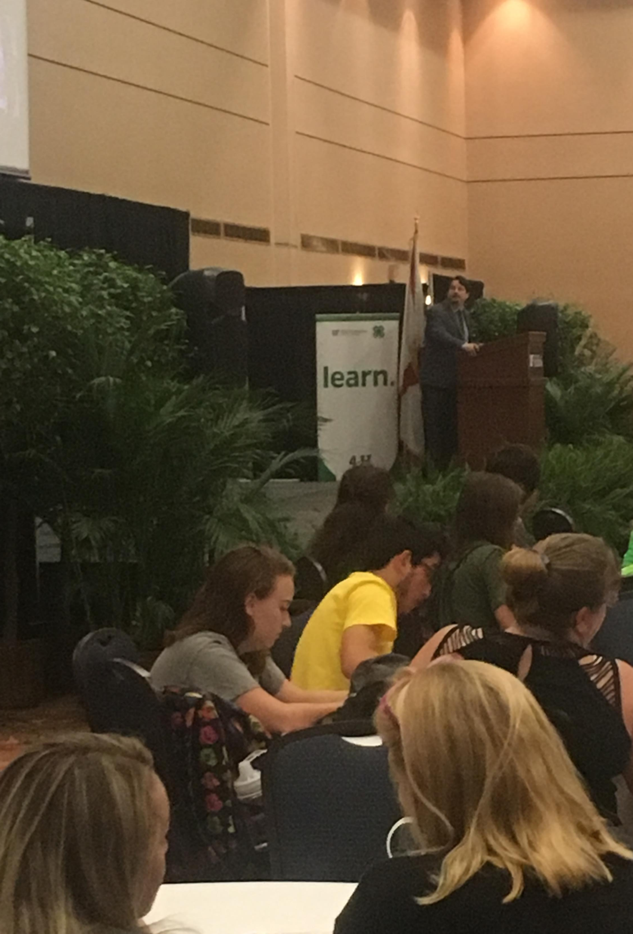
Additional Ways to Collect Data
Poll Everywhere Word Cloud link
https://PollEv.com/surveys/atGysHxMZVe5jfPXlU8pt/respond
Google Analytics (UF LinkedIn Learning)
Google Jam Board (UF Gsuite)
Kahoot Quiz
Zoom Polls
Poll Everywhere
Notes:
Make sure your platforms are approved through UF and adhere to their guidelines. Find that immediate collection of data is important
UF LinkedIn Learning- https://elearning.ufl.edu
Essential Training for Google Analytics

Slide 11
Data Received
Results
Notes:
You may not want/need this?
Data Received
Agents received a Qualtrics data report for each program and training was provided in how to conduct simple analysis of data received for their ROA along with sample outcome statements for how to report the data. Again Belonging and subject matter knowledge gain are both indicators that are I7 workload indicators and consistent with other Extension programs in PYD.

Slide 12
Making the best of 2020
Go as high up the performance scale as you can with the data you have
Explain new resources, new activities, and/or new audiences you reached
Compare and contrast audience reach with 2019, if it’s to your benefit

Slide 13
11th hour evaluation tactics
ROA Deadline for County Faculty = December 4
If you have participant contact information, you can still:
Send customized survey invitations to assess medium-term outcomes
KISS principle – now is not the time for lengthy inquiries!
Prioritize POW/POA/Workload indicators of medium-term outcomes
Send customized requests for client testimonials/success stories
If you don’t have participant contact information, you can still:
Email a survey link to a list of possible participants (e.g. Master Gardener listserv, 4-H family listserv, producer listserv) with instructions to fill it out if X applies to them
Post a survey link to social media
Scan social media comments for evidence of behavior change/application of information; report as qualitative data

Slide 14
What are the steps?
Create a data collection plan for evaluating each “Big P” program objective
Select a data collection design (a.k.a., evaluation design)
Implement data collection
Analyze and interpret results
Report in ROA

Slide 15
Create a data collection plan for evaluating each program objective
Objective | When | How | What | From whom
75 Homeowners add native plant beds to landscape | October 2021 | Qualtrics post-only survey | Have you created a new bed in your landscape with at least 50% native plants? What species did you include? | List of participants in Spring 2020 virtual native plant seminar series, FaceBook live demonstrations, and email consultations
Community groups identify local policy options to address climate change | July 2021 | Documents & media reports | Collect a list of the policy options identified and discussed | Group participants, local news reporters, city or county planning officials

Slide 16
Identify Tools for Data Collection
Types of designs: pre-test/post-test, post-then-pre, post-only, panel data (3 or more times)
Survey methods (see https://edis.ifas.ufl.edu/topic_series_savvy_survey)
Qualtrics libraries can support backs of questions and entire survey instruments
Non-survey methods (artifacts, secondary data, photos & video)
Use existing tools supported by PWGs that match your program objectives

Slide 17
Numerous Standard Tools

Slide 18
Options for Data Analysis
Simple quantitative measures in Qualtrics
Means and percentages
Simple crosstabulations
Better quantitative tools in Excel with EZAnalyze plug-in
Create summary measure for a set of items (e.g., IPM or FFL practices)
Create change measure for pre-test/post-test
Calculate 1-sample and Paired t-tests
Rigorous tools for quantitative analysis using SPSS via UF APPS
Qualitative methods (e.g., thematic analysis, quasi-quantitative methods with NVIVO or MaxQDA)

Slide 19
Data Analysis Resources
Savvy Survey Series pubs #15, 16 & 17 (see https://edis.ifas.ufl.edu/topic_series_savvy_survey)
Program Evaluation pubs (see https://edis.ifas.ufl.edu/topic_program_evaluation)
Data Analysis videos
Assessing Change for a Single Behavior https://youtu.be/dpUq00JD4q0
Asessing Change for a Set of Behaviors https://youtu.be/0__MoLUUoAQ
Using Results of Data Analysis in Reporting webinar
at: https://bit.ly/3lDqwOp

Slide 20
Questions or comments?
Matt Benge
mattbenge@ufl.edu
Amy Harder
amharder@ufl.edu
Glenn Israel
gdisrael@ufl.edu​
Sarah Hensley
sarahzt@ufl.edu

